Slide 1
June, 4th
Research Infrastructures in a Changing Global, Environmental and Socio-economical Context
Critical raw materials and supply chain challenges
Jana Kolar
Notes:
1

Slide 2
Outline of the talk
External factors affecting the resilience of the RIs
Past
Current
Future
2. Needed response by the RIs, policy makers, funders
Notes:
2

Slide 3
Past
External factors affecting the resilience of the RIs (5 year)
Past
Current
Future
2. Needed response by the RIs, policy makers, funders
Notes:
3

Slide 4
COVID-19
1. Crisis significantly impacted operations of RIs
2. Resilience of the RIs was demonstrated
3. Contribution of the RIs to provision of the solution
Notes:
4

Slide 5
Some Factors Currently Affecting RIs
1. Russian aggression on Ukraine
2. Red Sea Crisis
3. Cyber Security
Council
…has called on ESFRI, as well as RIs, to elaborate on
scenarios to manage possible upcoming crises, including energy supply difficulties*
… Tenerife Declaration
*Research Infrastructures - Council conclusions (approved on 2 December 2022) 15429/22
Notes:
5

Slide 6
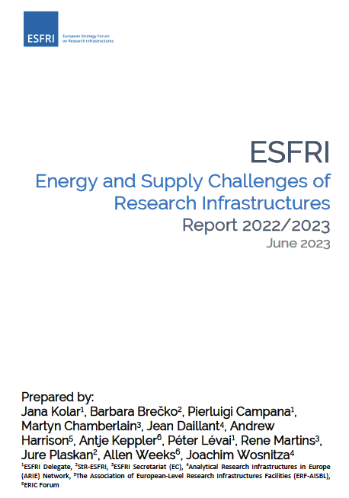
ESFRI’s response
Assessment of impact and responses
Recommendations to
National policymakers
ESFRI
The EC
RIs
ESFRI Report on Energy and Supply Challenges of Research Infrastructures. Zenodo. 2023 https://doi.org/10.5281/zenodo.8123921
Notes:
6

Slide 7
Impact of the Current Challenges
1 Energy Crisis
High energy costs impacting the operation of energy-intensive RIs (ongoing)
Synchrotrons and computing centres are among the most affected RIs
2 Material Shortages
Critical shortages of gases
Dependence on non-European suppliers for isotopes, specific equipment and parts
3 Increased Delivery Times
Doubling delivery times for essential equipment and parts
Delays affecting project timelines and scientific outputs (affecting RRF, etc)4.
4. Increased Prices (inflation)
Notes:
7

Slide 8
Some Future Challenges
Climate change
Critical raw materials
Research Security
Foreign Infringement….
Notes:
8

Slide 9
Some Future Challenges 1. – Greening of RIs
Climate change
Political commitments
55% reduction of greenhouse gas emissions by 2030 (compared to 1990)
Climate-neutral by 2050
2. The impacts on RIs
Prepare the plans on how to contribute to the targets
Support by the funders
Notes:
9

Slide 10
Some Future Challenges 2. - Critical Raw Materials
Permanent Magnets
Widely used in advanced technologies, including synchrotrons (insertion devices, storage rings)
Essential for reducing energy consumption
Geopolitical Risks
High concentration of critical raw materials in specific regions
Potential supply disruptions due to geopolitical tensions
Role of RIs
Development of strategies to mitigate risks
Collect & recycle
Contribution to Innovation (e.g. Advanced Materials JU)
Notes:
10

Slide 11
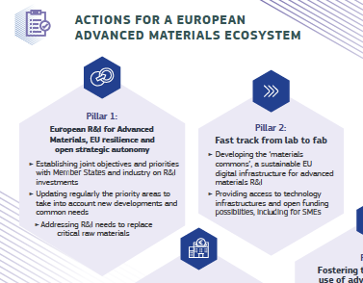
Conclusions
Strategic Importance
Autonomy and resilience of RIs are crucial for the EU’s scientific and technological leadership
Call to Action
RIs to engage in:
- risk assessment and mitigation
- innovation
Strategic guidance of ESFRI and national policymakers and funders
Finances
Notes:
11

